Slide 1

Capstone Project II
Group no : 496
Himanshu Kumar 11605569
Vaibhav Garg 11602929
Ajesh 11606140
Rishabh Soni 11616877
Under the Guidence of
Miss Ankita Arora ( 23793 )

Slide 2

Cinch parkin'

Slide 3

Introduction
Problem Identification
Solution with Technology
Scope and Vision
Overview

Slide 4

Various Technologies
Internet of Things (IoT)
Database and Cloud
Application Development
Various steps
Creating Hardware Device
Coding The Hardware
Creating and Managing Firebase
Developing user Interface (Ionic App)
Programming Languages
Python 3
Arduino Programming

Slide 5

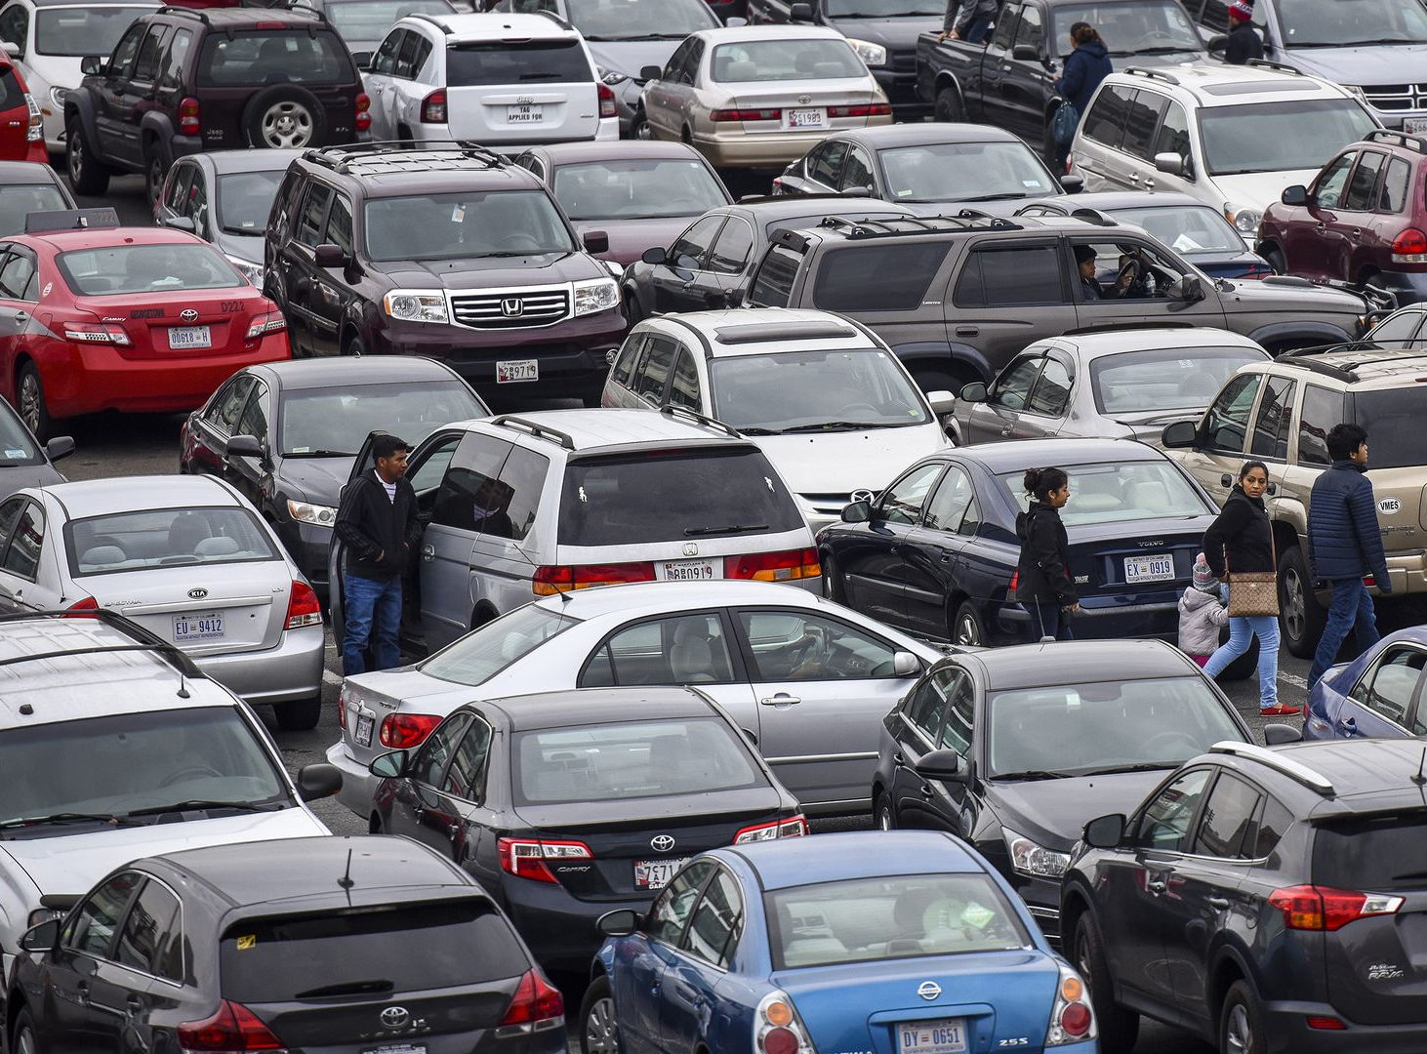
Problem…..!!!

Slide 6

Save Time
Save Fuel
Reducing Stress
Easy Process
No Human Intervantion

Slide 7
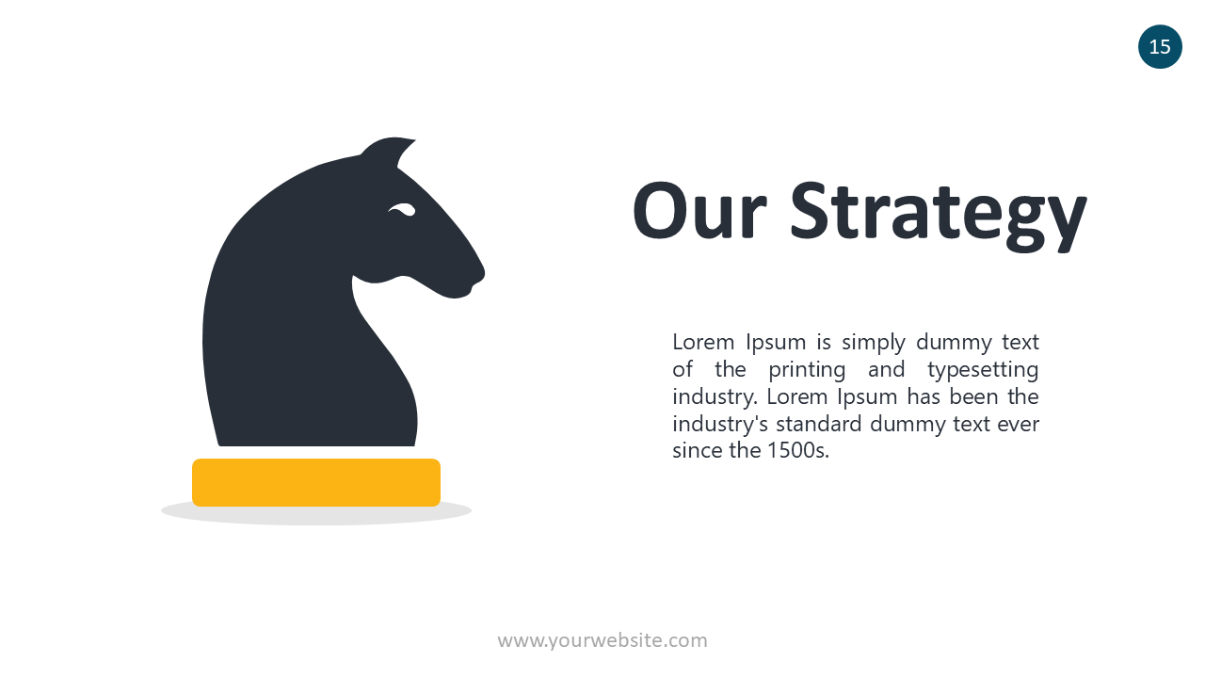
Step 1. Creating an hardware Design
Step 2. Creating Circuit Design​
Step 3. Connecting Sensors/Actuators ​​
Step 4. Coding the Development board​​​
Step 5. Creating and managing Database​​​​
Step 6. Application Development​​​​​
Step 7. Testing and Implementation​

Slide 8
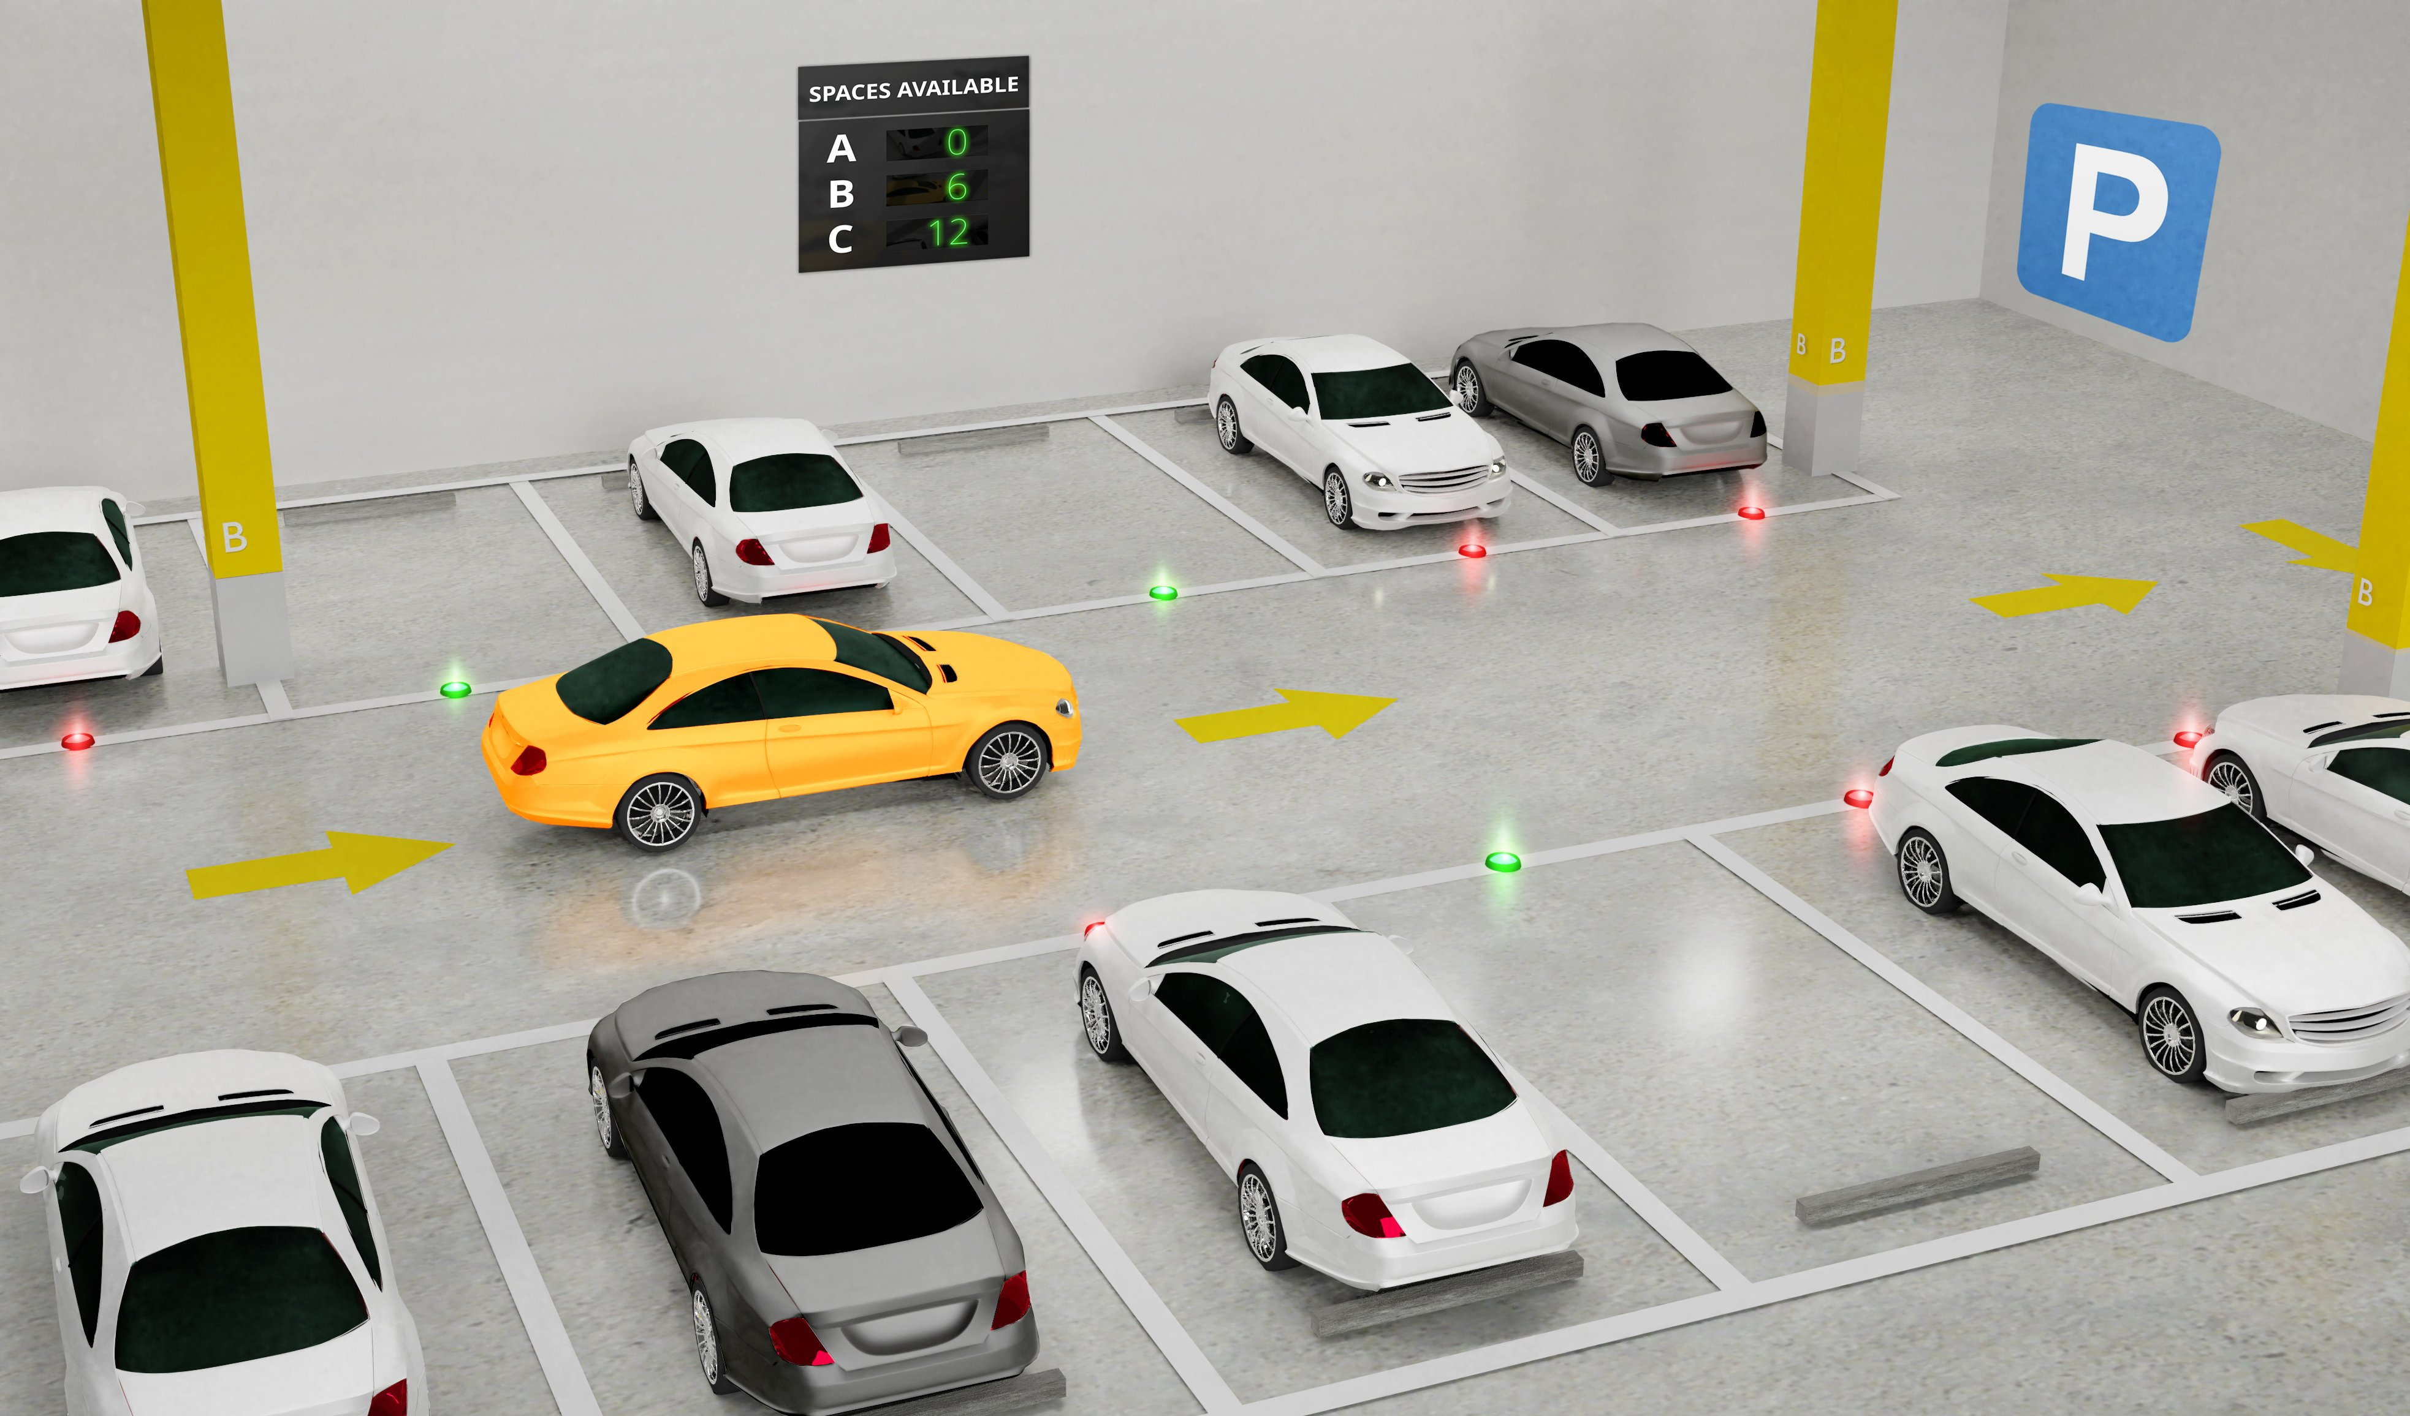

Slide 9

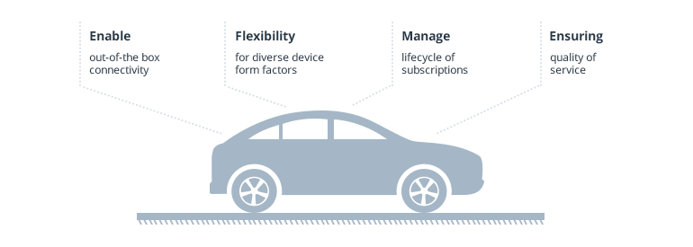
Features

Slide 10

HARDWARE

Slide 11
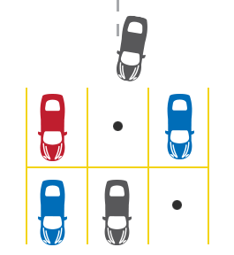

Slide 12
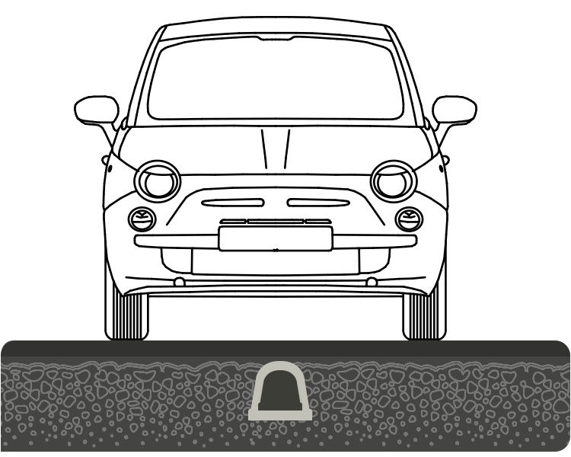

Slide 13

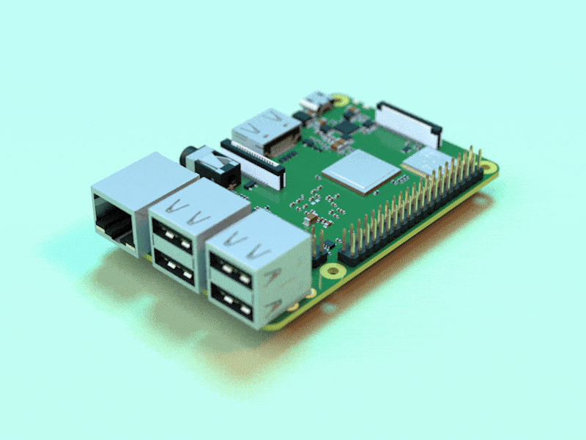

Slide 14
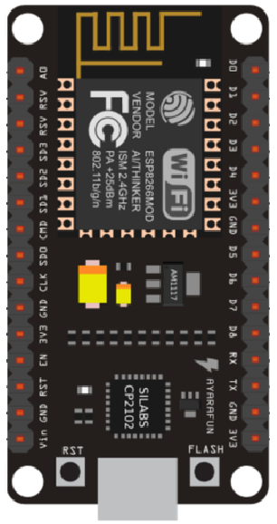

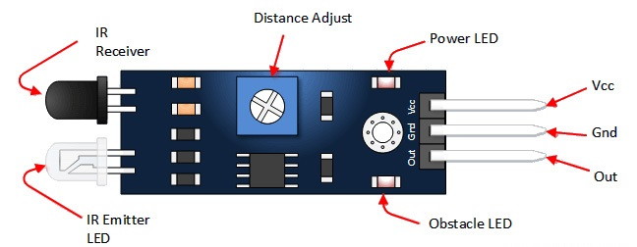
IR Sensor
Node MCU
Servo motor

Slide 15
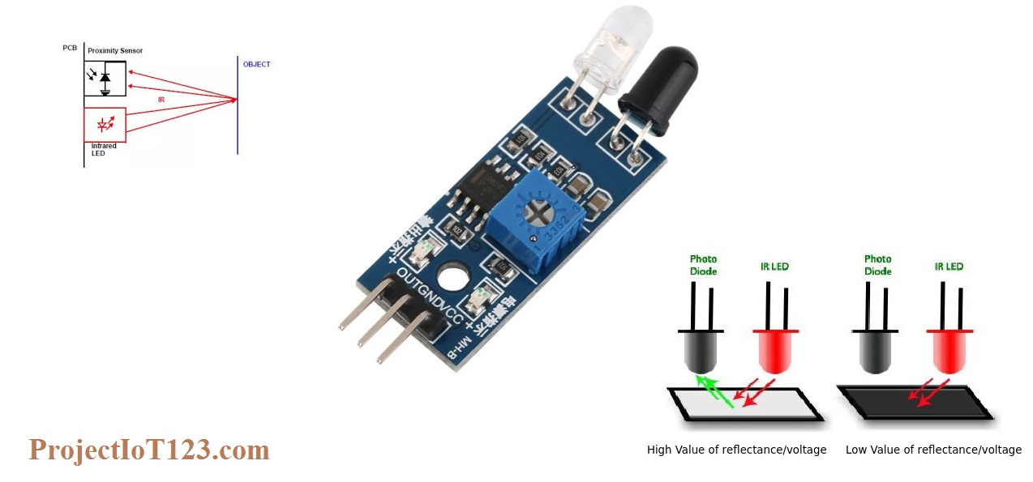

Slide 16
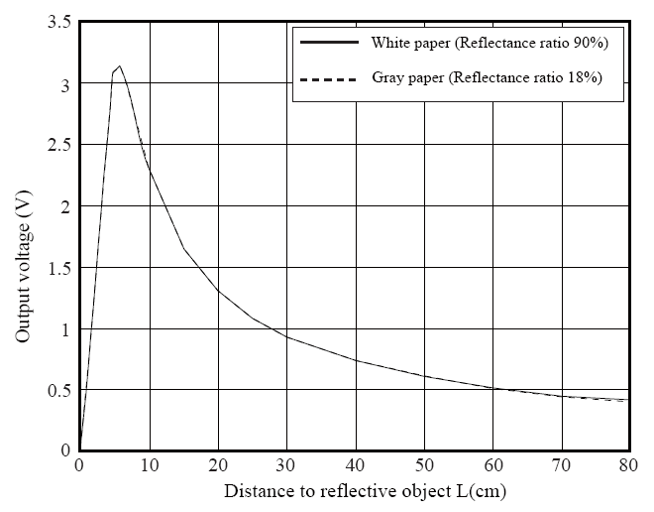

Slide 17


Slide 18
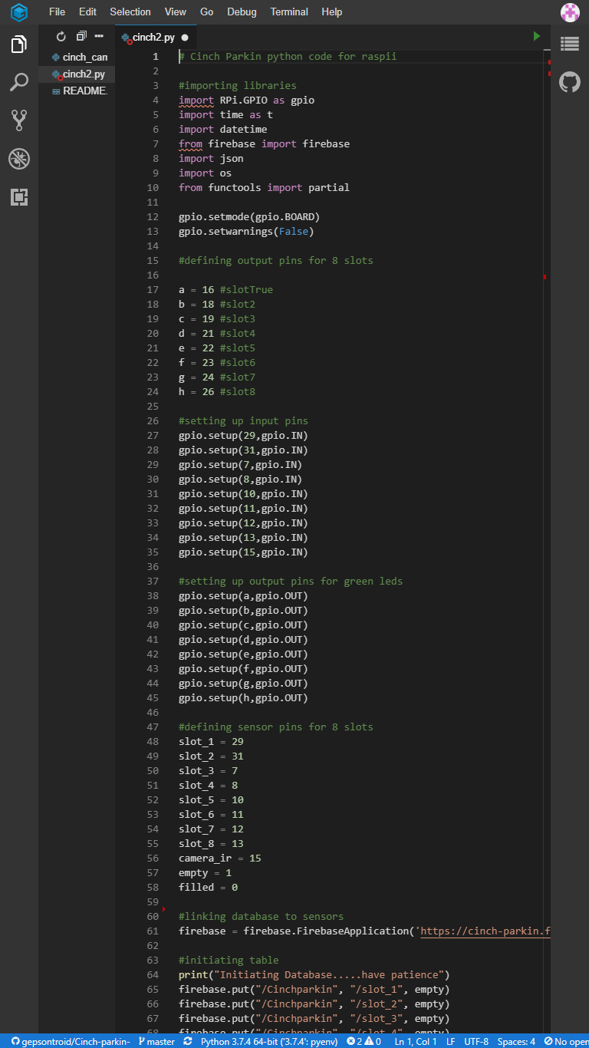
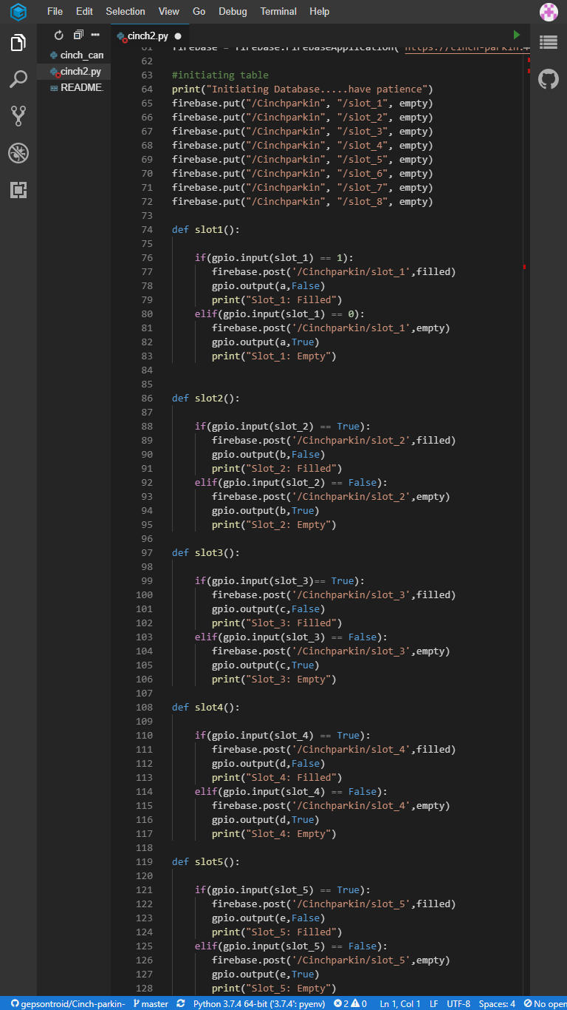
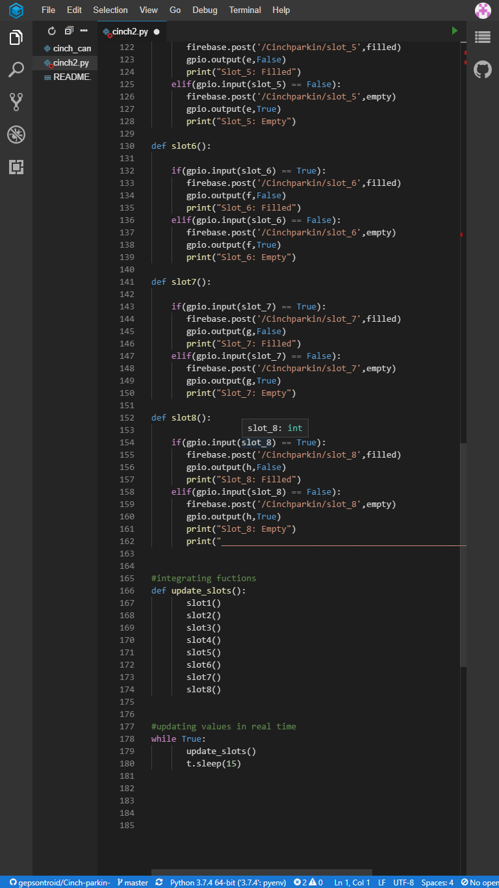

Slide 19
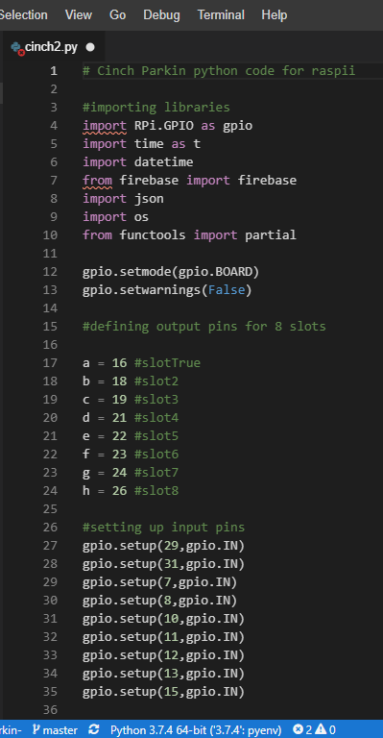
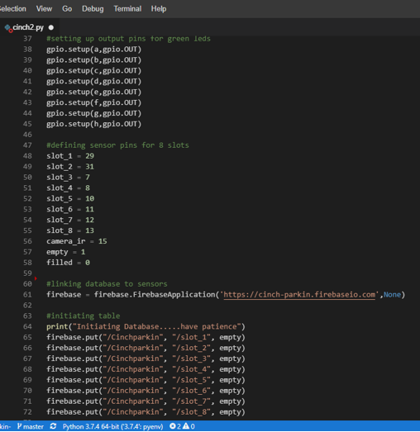

Slide 20
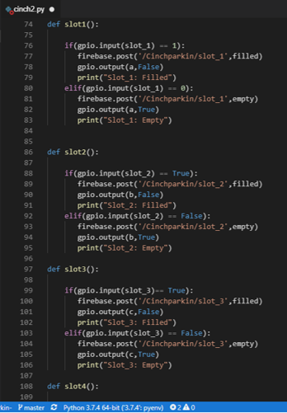
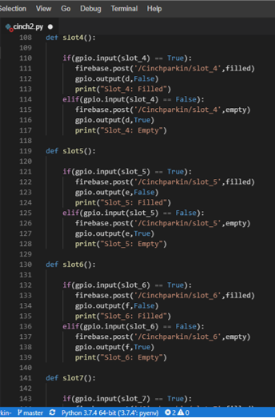
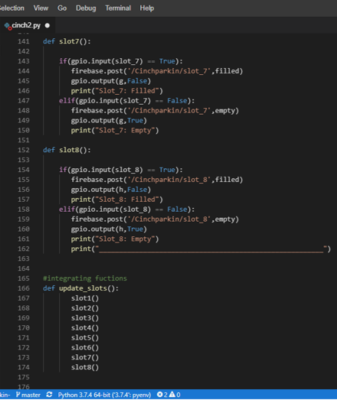

Slide 21
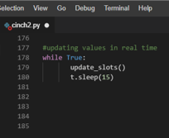

Slide 22


Slide 23
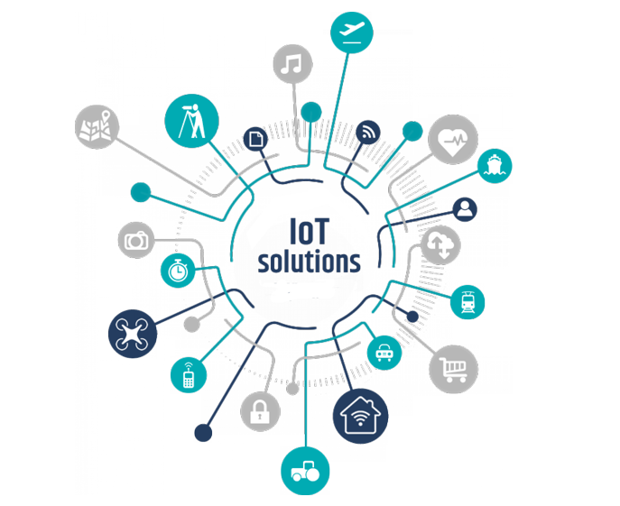


Slide 24
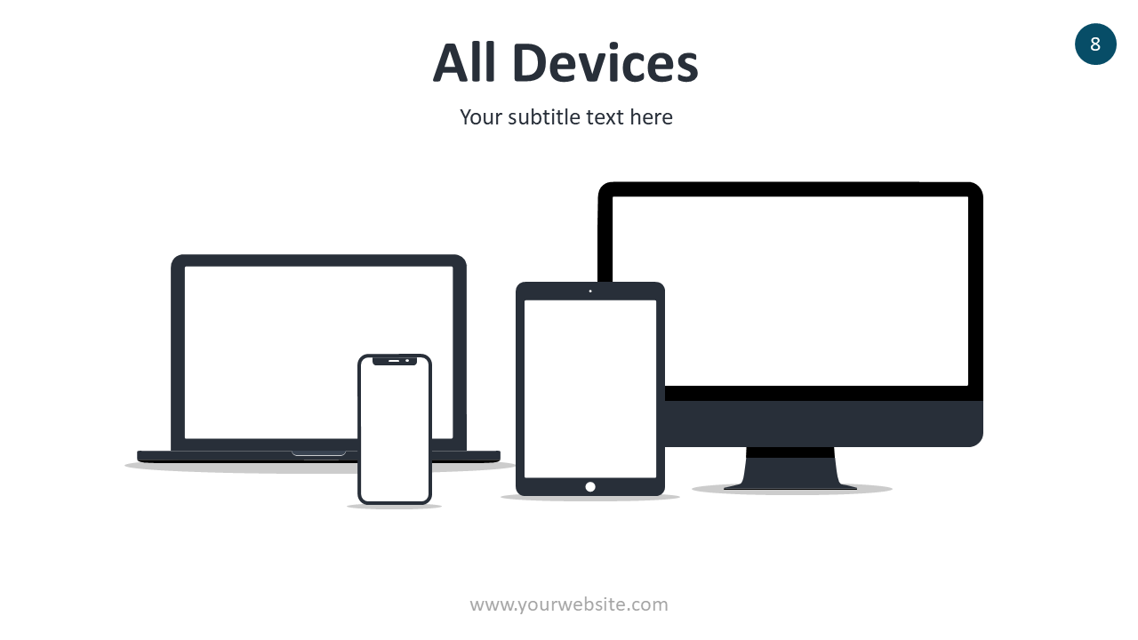
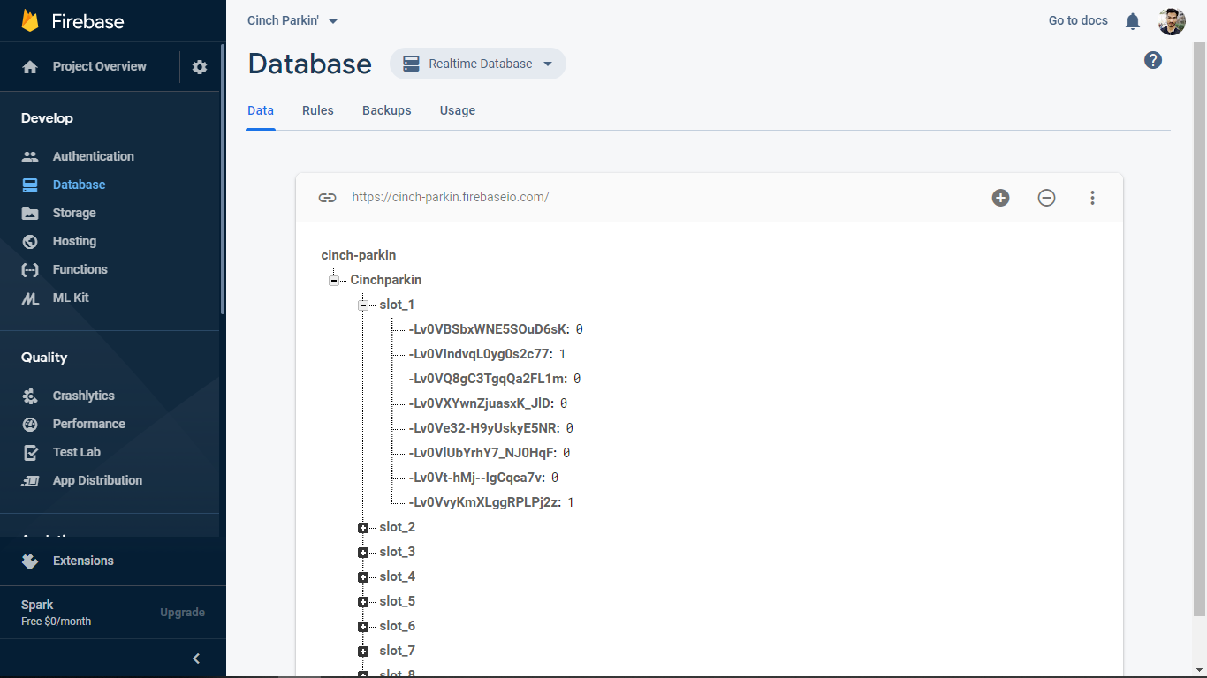
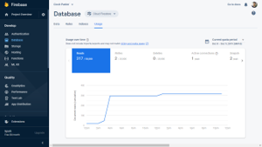
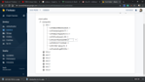
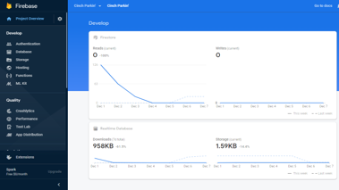
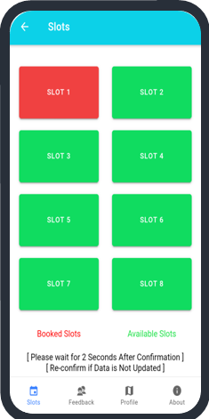
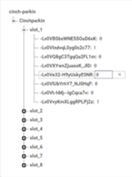

Slide 25


Slide 26
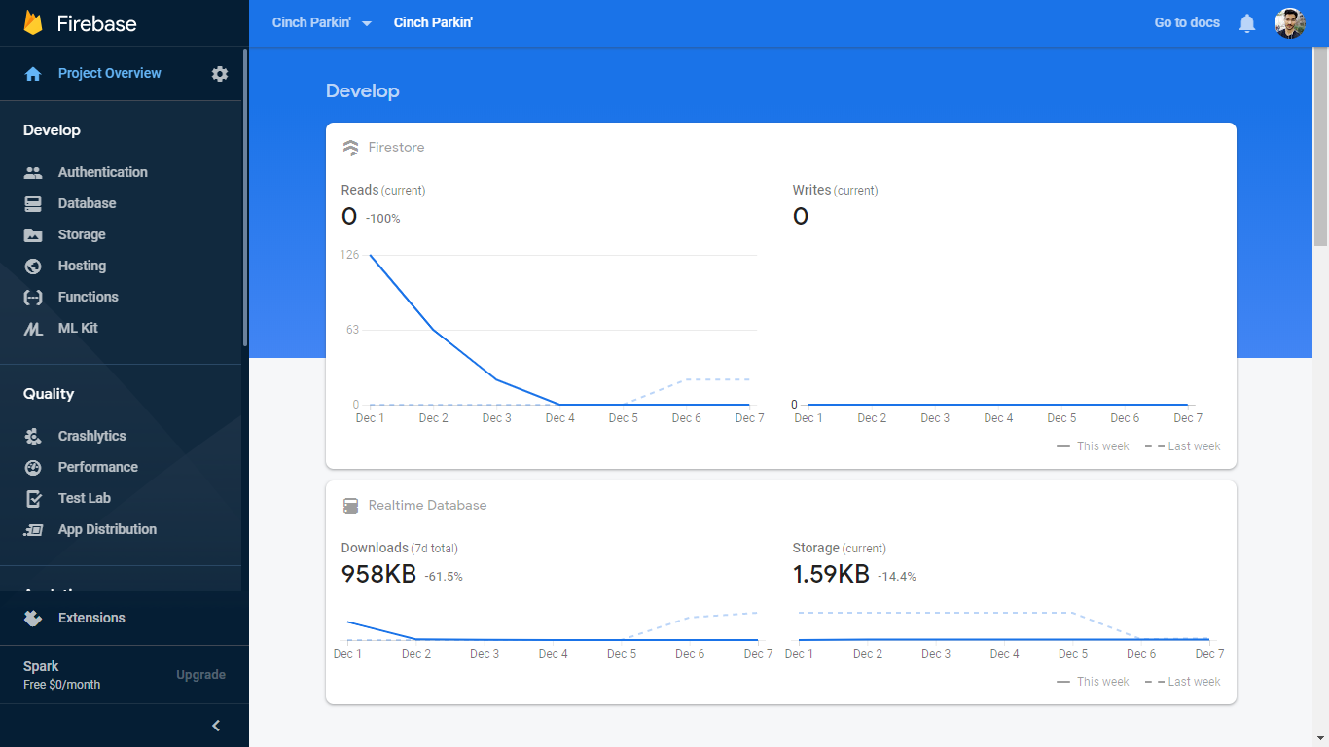

Slide 27
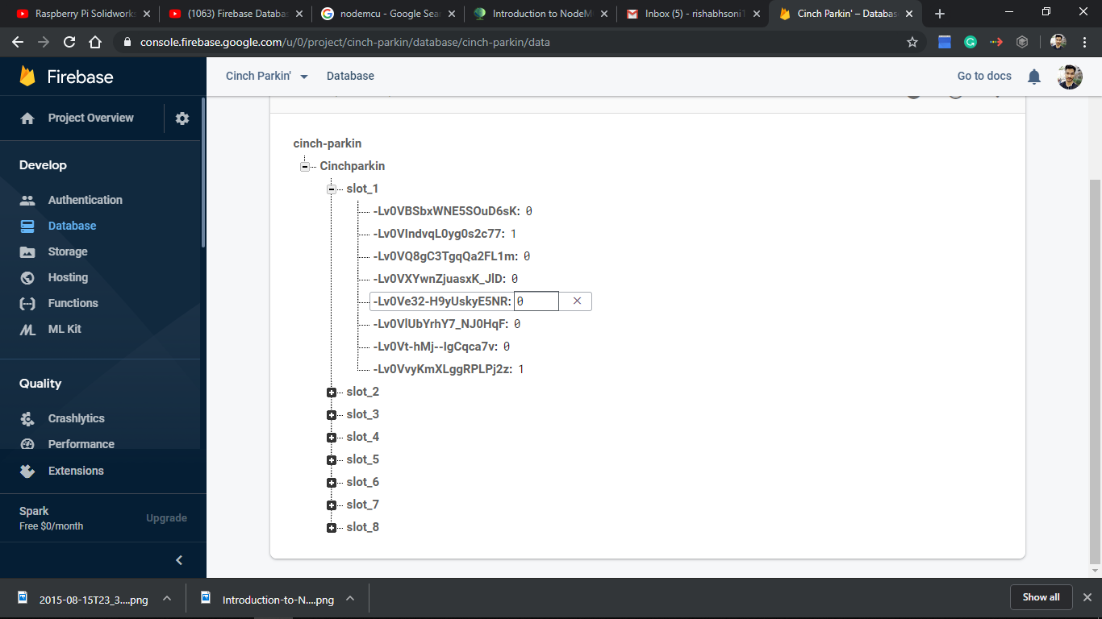

Slide 28
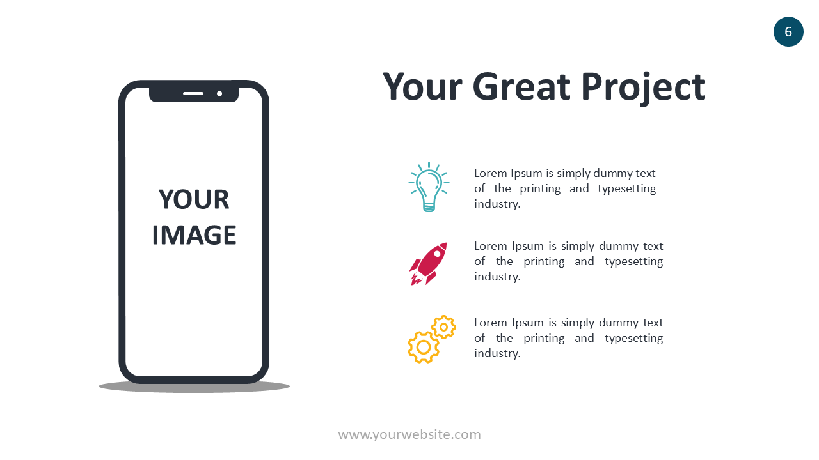
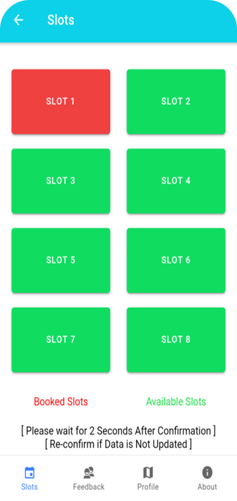
APPLICATION

Slide 29
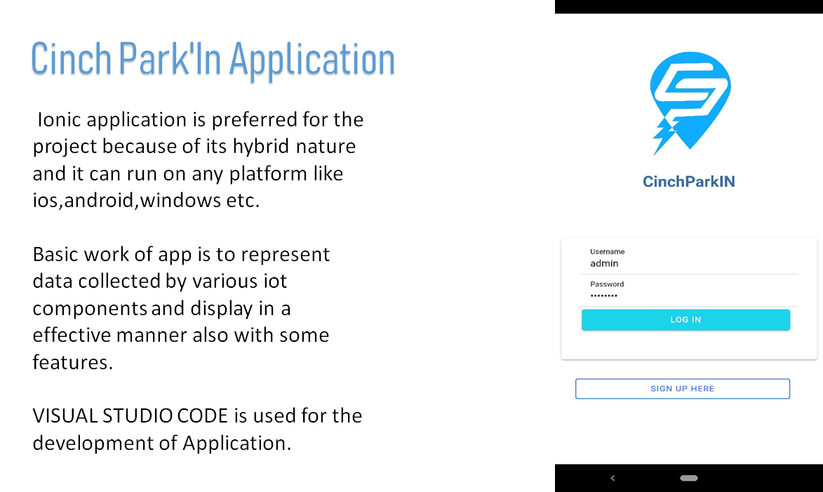

Slide 30
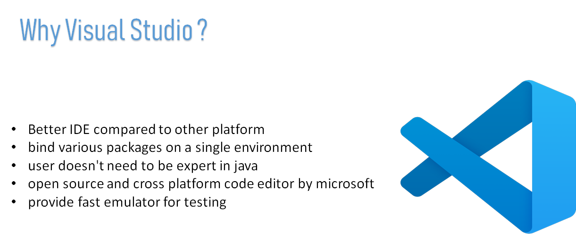

Slide 31
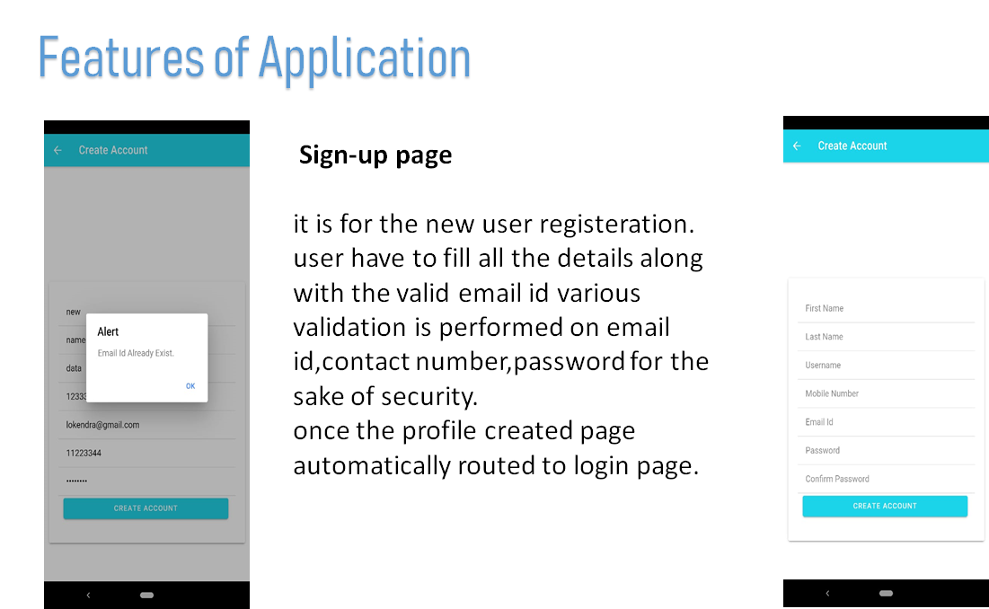

Slide 32
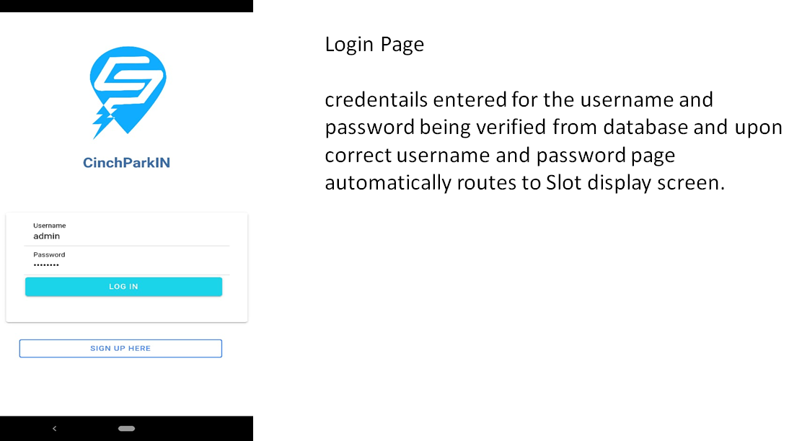

Slide 33
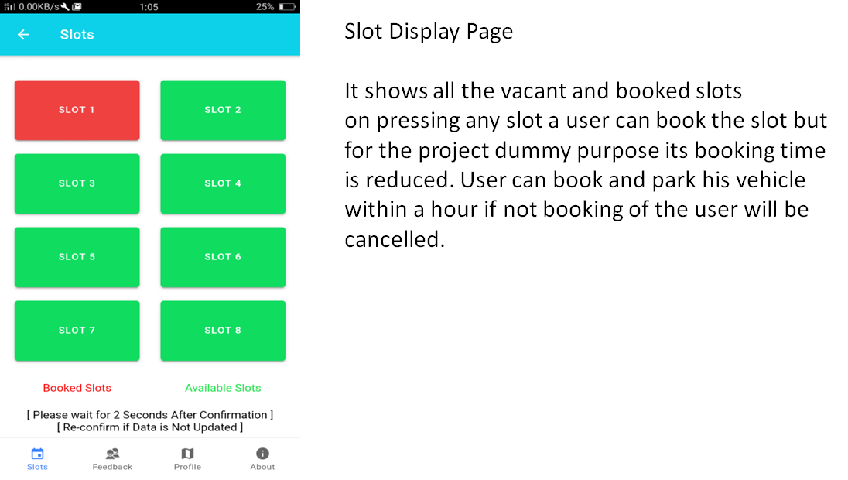

Slide 34
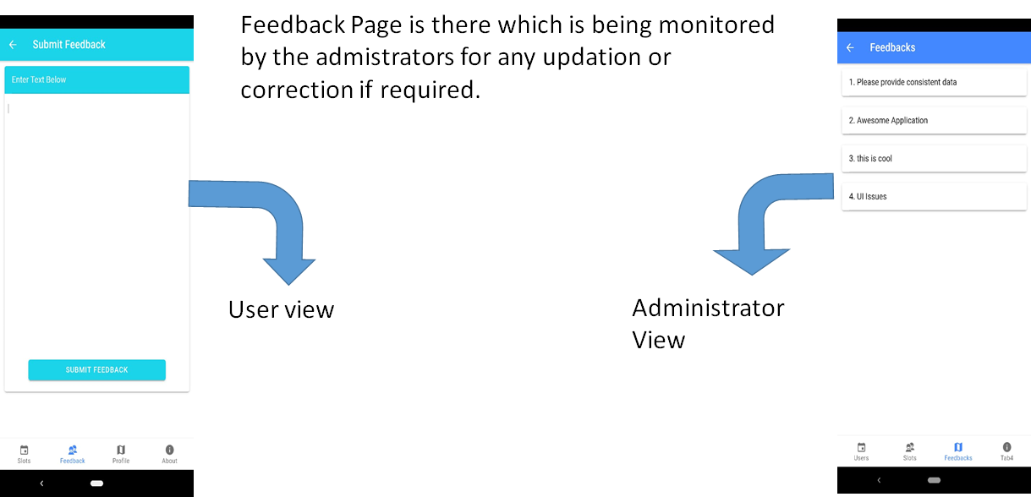

Slide 35
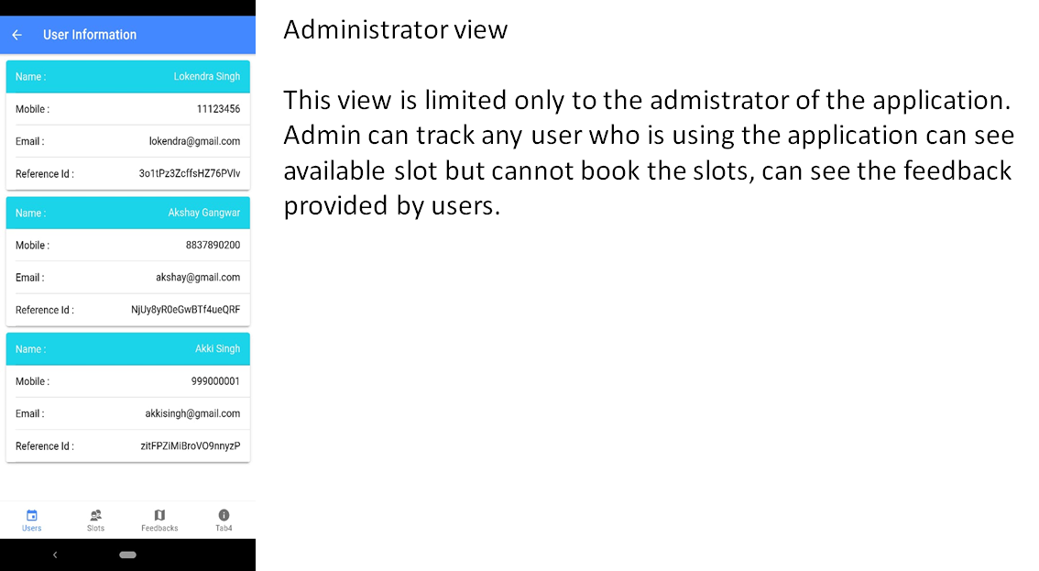

Slide 36
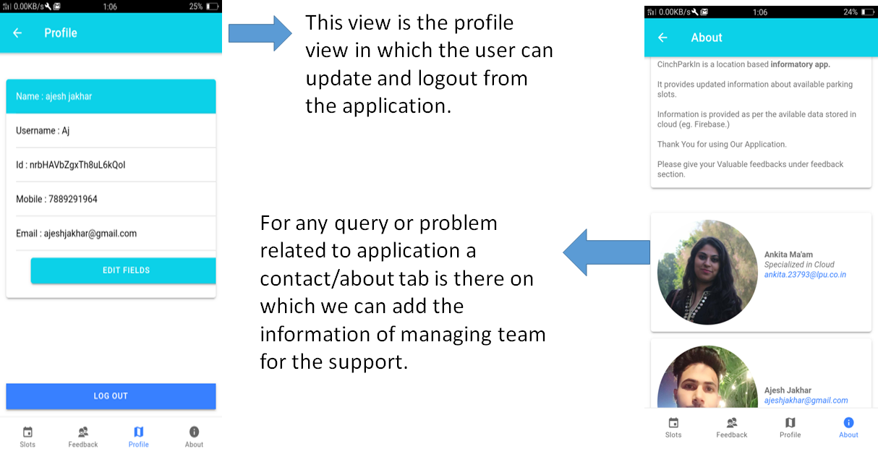

Slide 37




Slide 38
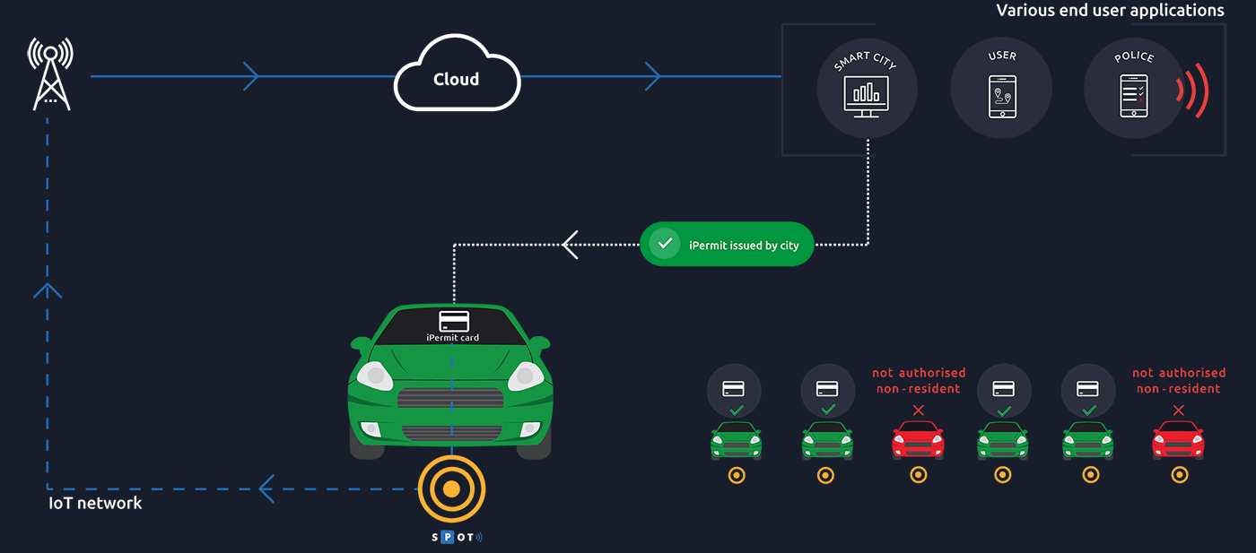

Slide 39


Slide 40



Slide 41


